Slide 1
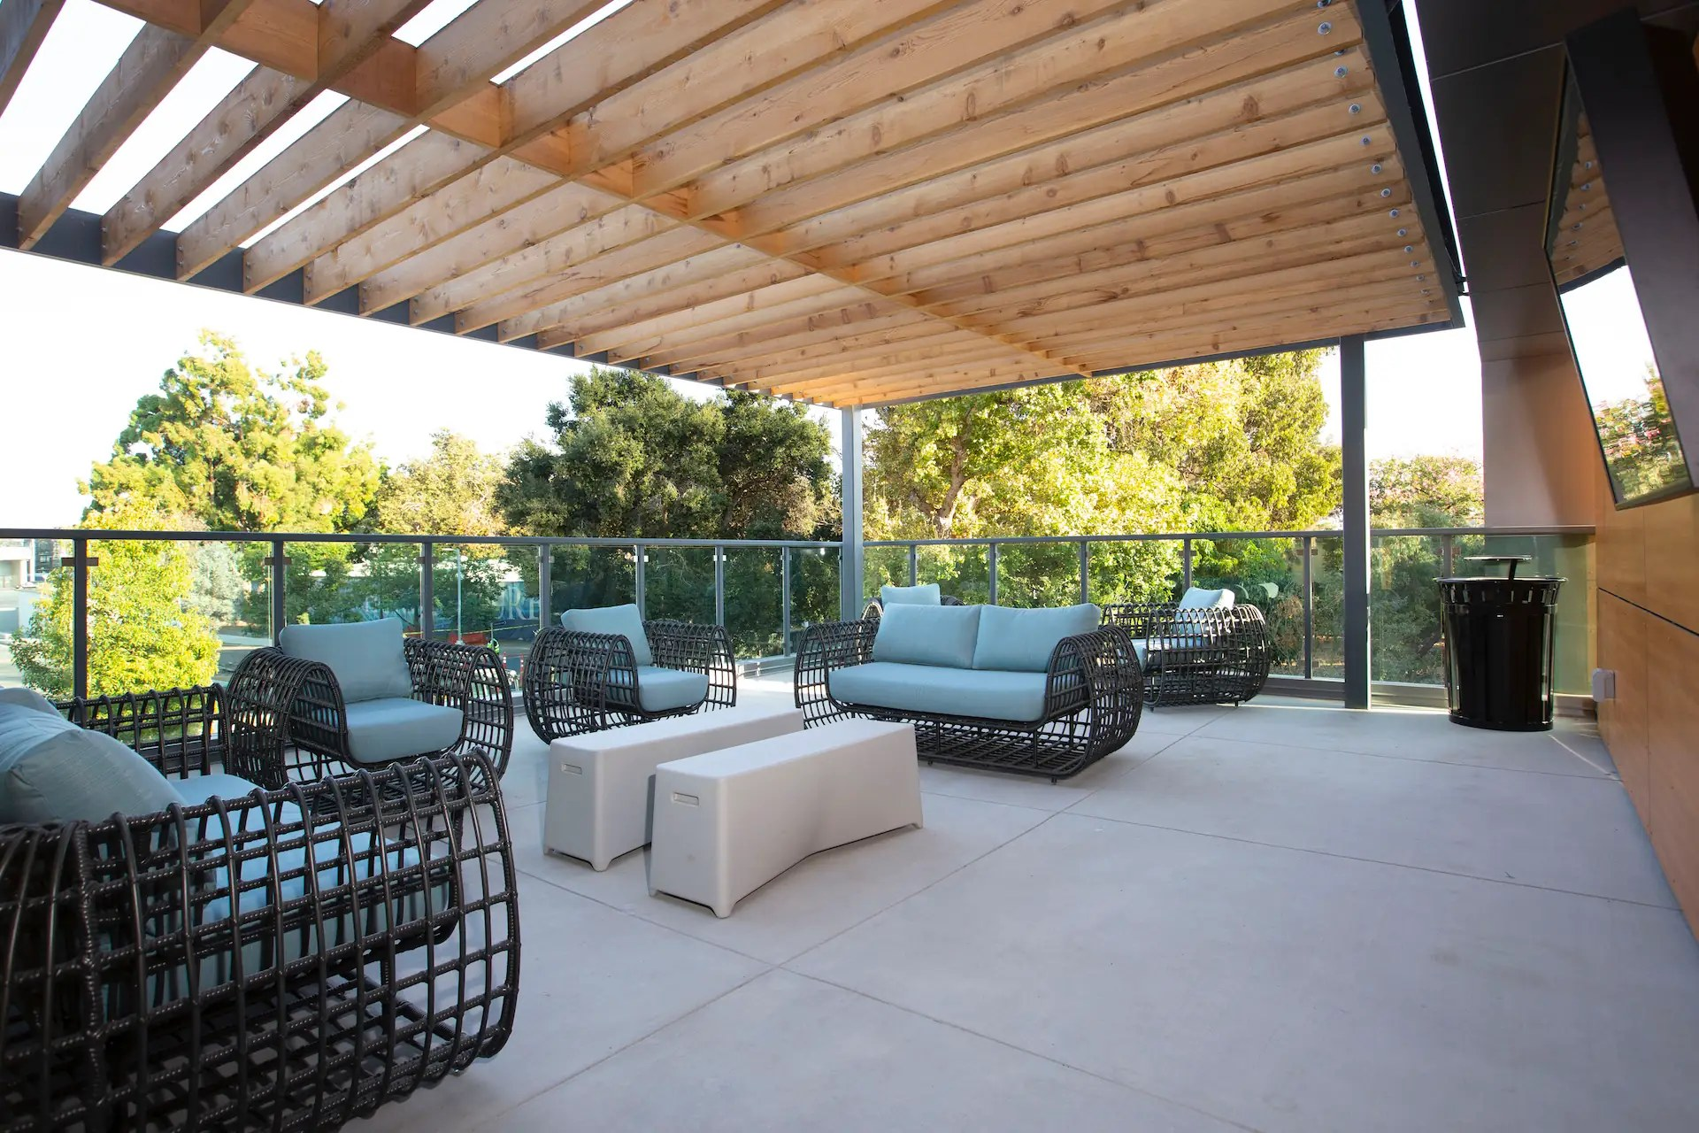

RESIDENT ASSISTANT TRAINING
ResLife Hub & Creative Studio
Every tab you can use as an RA — and exactly how to use it.
The Harbour at Orange Coast College · Resident Life
Notes:
Welcome to The Harbour at Orange Coast College Resident Assistant training for the ResLife Hub and the Creative Studio. In this video we will walk through every tab you have access to as an RA, what each one is for, and step by step how to use it. Keep the Hub open in another window so you can follow along.

Slide 2
AGENDA
What you will learn
Getting Started
Team & Programs
On Duty
Reference & Creative
Logging in
The header & notifications
Your sidebar map
Dashboard
Announcements
Program Proposals
Committees
Schedule & On-Call
Duty Log (desktop & phone)
Guest Log
Incident Reports
Maintenance & Keys
Resident Directory
Contacts, Curriculum, SOPs, Resources
Training Modules
Creative Studio
TIP Pause the video at any step and try it in the Hub. Nothing you click in this training changes another RA's work.
Notes:
Here is the plan. We start with the basics: logging in, the header, your sidebar, and the Dashboard. Then team and program tools: Announcements, Program Proposals, Committees, and the Schedule. Then your on-duty tools: the Duty Log, Guest Log, Incident Reports, and Maintenance and Keys. We finish with reference tabs and the Creative Studio.

Slide 3

01
Getting Started
Logging in, finding your way around, and staying on top of notifications.
Notes:
Section one: getting started.

Slide 4
GETTING STARTED
Logging in & landing
Go to the Hub login page and enter your Username and Password. Tick Show password if you need to check it.
The Harbour at OCC
1
🔔 RA Log Out
Dashboard
DASHBOARD
2
Click Sign In. RA accounts go straight to the ResLife Hub.
Announcements
Program Proposals
Open Incidents · Open Maintenance · My Upcoming Shifts
You land on the Dashboard. Bookmarked links (like the Duty Log shortcut) open that tab directly.
Committees
Pinned & Recent Announcements
3
Schedule & On-Call
Duty Log
On Call Now · My next duty
If you see “Your account is not tied to a property yet” — contact your Reslife Admin.
Guest Log
Incident Report Assistant · + New Report
4
Incident Reports
Maintenance & Keys
5
You are signed out after 12 hours of inactivity. Use Log Out on shared computers.
IMPORTANT Never share your login. Everything you submit is recorded under your name.
Notes:
To log in, go to the Hub login page and enter the username and password your Reslife Admin gave you. Click Sign In and you will land on the ResLife Hub Dashboard. If you ever see a message that your account is not tied to a property, reach out to your Reslife Admin. For security, the Hub signs you out after twelve hours of inactivity, and you should always click Log Out on a shared computer. Never share your login, because everything you submit is recorded under your name.

Slide 5
GETTING STARTED
The header: notifications, feedback & your account
🔔 Notifications bell
💬 Feedback button
👤 Your account
Badge shows unread items (checks every 20 sec)
Click an item to jump to its tab
Mark all read · Sound on/off
Urgent announcements pop up — click Got it
Navy pill, bottom-right of every page
Choose Error / Bug, Feature request or Question
Add a summary + optional screenshot (paste with Ctrl/⌘+V)
Click Send
Role badge reads Reslife - RA
Property switcher appears only if you have more than one property
Log Out button
Sidebar Collapse / Expand at the bottom
☰ The Harbour at OCC RESLIFE HUB 🔔 3 Reslife - RA username Log Out
TIP Turn on browser notifications so you hear about urgent announcements, swaps and creative approvals right away.
Notes:
Across the top of every page is the header. The bell shows your unread notifications: announcements, program updates, shift changes and creative approvals. Click any item to jump right to it, or click Mark all read. Urgent announcements pop up on screen; read them and click Got it. At the bottom right of every page is the Feedback button. Use it to report a bug, request a feature, or ask a question, and you can paste in a screenshot. Your role badge shows Reslife RA, and if you work at more than one property you will see a property switcher. Log Out is on the right.

Slide 6
GETTING STARTED
Your sidebar: the tabs RAs can use
Dashboard
Your property at a glance
Announcements
Team news (read-only)
Program Proposals
Plan & submit programs
Committees
Rosters & meeting minutes
Schedule & On-Call
Shifts, swaps, availability
Duty Log
Calls & incidents per shift
Guest Log
Check guests in & out
Incident Reports
Quick incident log
Maintenance & Keys
Work orders & lockouts
Resident Directory
Residents & history
Campus Contacts
Who to call on campus
Curriculum Tracker
Your required items
SOP Library
Written procedures
Resources
Links & property info
Training Modules
Lessons & quizzes
Creative Studio ↗
Flyers, posts, emails
Also in the sidebar (open in a new page): Incident Report Assistant · Curriculum Management · Collateral Hub
Notes:
This is your sidebar map. As an RA you can use the Dashboard, Announcements, Program Proposals, Committees, Schedule and On-Call, Duty Log, Guest Log, Incident Reports, Maintenance and Keys, Resident Directory, Campus Contacts, the Curriculum Tracker, the SOP Library, Resources, Training Modules, and the Creative Studio. A few sidebar links, like the Incident Report Assistant, Curriculum Management and the Collateral Hub, open their own pages. Some tabs you may hear about, such as Safety Records or Manage Users, are for RECs and Admins only, so you will not see them.

Slide 7
GETTING STARTED
Dashboard
Stat cards — Open Incidents, Open Maintenance & Keys, My Upcoming Shifts, Active Program Proposals, Committees, SOP entries, Training Modules. Click a card to open that tab.
Pinned & Recent Announcements — the five latest, pinned first.
On Call Now — who is on call, My next duty, and View Schedule.
Incident Report Assistant — + New Report and your last five drafts with Continue.
The Harbour at OCC
🔔 RA Log Out
Dashboard
SIGNED IN AS YOU (RESLIFE - RA)
Announcements
3 Open Incidents · 2 Open Maintenance · 4 My Shifts
Program Proposals
Committees
📌 Pinned: Fall Opening Duty Expectations
Schedule & On-Call
On Call Now: RA on duty · Duty phone
Duty Log
Guest Log
Draft · Noise complaint 10/12 — Continue
Incident Reports
Maintenance & Keys
TIP Start every shift on the Dashboard: check On Call Now and any pinned announcements first.
Notes:
The Dashboard is your home base. The stat cards across the top show open incidents, open maintenance and key requests, your upcoming shifts, active program proposals and more. Click any card to jump into that tab. Below that you will see pinned and recent announcements, the On Call Now panel showing who is on duty and your next duty shift, and the Incident Report Assistant where you can start a new report or continue a draft. A good habit is to start every shift here.

Slide 8
TEAM & PROGRAMS
Announcements
Your team’s news feed: posts from RECs and Admins with text, images, GIFs and video.
📌 Pinned posts stay at the top — these are expectations you are responsible for.
Each post shows the author, how long ago it was posted, and if it was edited.
Urgent announcements also pop up and appear in your 🔔 bell.
RAs read announcements; posting, editing and pinning are for RECs and Admins.
The Harbour at OCC
🔔 RA Log Out
Dashboard
ANNOUNCEMENTS
Announcements
📌 Pinned · Duty phone hand-off reminder · REC · 2d
Program Proposals
Committees
Halloween program sign-ups are open · 5h
Schedule & On-Call
Fire drill Thursday 10 AM · edited · 1d
Duty Log
Guest Log
Welcome back! · 1w
Incident Reports
Maintenance & Keys
TIP If something in an announcement is unclear, ask your REC — do not guess on policy.
Notes:
Announcements is your team news feed. RECs and Admins post updates here, sometimes with images or video. Pinned posts stay at the top and usually contain expectations you are responsible for, so read them carefully. Urgent announcements will also pop up on your screen and show in your bell. As an RA you read announcements; posting and pinning is handled by RECs and Admins.

Slide 9

02
Program Proposals
Plan, budget and submit programs for REC approval — then track tasks and report results.
Notes:
Section two: Program Proposals, where you plan and submit your programs.

Slide 10
TEAM & PROGRAMS
Program Proposals: the overview
Switch views: Dashboard / List / Calendar (Month or Week).
Stat strip: Upcoming, Awaiting approval, Needs revision, Missing action items, Pending purchases, Overdue tasks, Completed, Est. budget.
Filter by status, type, category, RA, REC and dates — or tick Mine only.
Dashboard cards show what needs you: Changes requested, Missing Action Item List, Awaiting evaluation, and deadlines in the next 7 days.
Buttons: Templates and + New Program Proposal.
The Harbour at OCC
🔔 RA Log Out
Dashboard
PROGRAMMING
+ New Program Proposal
Announcements
Upcoming 4 · Awaiting 2 · Needs revision 1
Program Proposals
Committees
⚠ Changes requested — Study Snacks Night
Schedule & On-Call
Missing Action Item List — Movie Night
Duty Log
Guest Log
Due in 7 days: Purchase request — Craft Night
Incident Reports
Maintenance & Keys
TIP Check Needs revision and Missing action items weekly — those are waiting on you, not your REC.
Notes:
Program Proposals is where you plan your programs. You can view everything as a dashboard, a list, or a calendar. The stat strip shows what is upcoming, what is awaiting approval, and anything that needs revision. Use the filters or tick Mine only to see just your programs. The dashboard cards highlight what needs your attention, like changes your REC requested or missing action items. To start, click New Program Proposal, or click Templates to begin from a template or a past program.

Slide 11
TEAM & PROGRAMS
Creating a proposal: Steps 1 & 2
Step 1 · Program Information
Step 2 · Program Purpose
Program Title* — e.g. “Valentine’s Day Craft Night”
Program Type* — Phase 1: Individual · Phase 2: Collaborative (add Collaborating RAs*) · Large Scale
Format — Active (in-person) or Passive (bulletin board, tabling, kits)
Programming Category* — Academic Excellence, Campus Pride, EDI, Health & Wellness, Holistic Development, Safety & Bystander Prevention
Assigned REC, Estimated Attendance, Program Date*, Start/End Time, Location*, Target Audience
Program Description* — click the ⓘ and Insert this template for a guide: vision, what residents will do, partners
Learning Objectives* — “Residents will be able to…”
Engagement goals, connection to category, intended outcomes
Stations & Assignments — Station, who’s involved, location, their job (+ Add station)
TIP Fields marked * are required to submit — but you can Save Draft anytime. Drafts also auto-save once you add a title.
Notes:
Click New Program Proposal to open the five-step wizard. In step one, Program Information, enter a title, choose the program type, either Individual, Collaborative, or Large Scale, and pick Active or Passive format. Choose your programming category, your assigned REC, the date, times and location. In step two, Program Purpose, write your description. Click the little i icon and Insert this template for a helpful outline. Then add your learning objectives, starting with Residents will be able to. If your program has stations, list who runs each one. Fields with a star are required to submit, but you can save a draft at any time, and drafts auto-save once there is a title.

Slide 12
TEAM & PROGRAMS
Steps 3–5: logistics, action items & submit
Step 3 · Logistics
Step 4 · Action Items & Budget
Step 5 · Review & Submit
Space reservation needs
Equipment requirements
Setup & breakdown (or install & removal)
Promotion / marketing
Accessibility considerations
+ Purchase — item, type, vendor, link, unit cost, qty, fulfillment, needed by
+ Supply on hand · + Flyer / Marketing request · + Task / Other
Add each vendor’s tax, delivery, service, Instacart fees & tip
Or tick “No supplies, purchases or action items needed”
Shows anything “Still needed before you can submit”
Shows who it goes to (your REC or all RECs)
Click Submit for Approval
IMPORTANT All purchases use the Emburse Card (MasterCard). Out-of-pocket reimbursements are not permitted.
Notes:
Step three covers logistics: space, equipment, setup and breakdown, promotion, and accessibility. Step four is your action item list and budget. Add purchases with the vendor, link, cost and quantity, plus any supplies you already have, flyer or marketing requests, and tasks. Enter each vendor’s tax, delivery fees, Instacart fees and tip, because nothing is assumed. If your program needs nothing, tick the No supplies box. Step five reviews everything and tells you what is still missing. When it is complete, click Submit for Approval. Remember: all purchases use the Emburse card, and out-of-pocket reimbursements are not permitted.

Slide 13
TEAM & PROGRAMS
Purchasing rules the Hub reminds you about
🛒 Amazon = non-food only
🚫 Costco Food Court
🚚 Delivery & Instacart
Supplies, decorations and other non-food items. Buy food & drinks locally (Costco, Vons, Target), often through Instacart.
Does not accept MasterCard — it cannot be paid with the Emburse card.
Add the vendor’s delivery/service fees and tip. Instacart orders must include Instacart fees and tip.
🏬 Pickup orders
🧊 Perishables
💲 Over budget
Add a needed-by date and the RA responsible, and coordinate pickup with your REC.
Confirm the pickup window and that refrigeration is available.
The Hub flags it when your estimate is more than the approved budget.
These are warnings only — the Hub never changes your numbers for you.
Notes:
As you build your budget, the Hub shows purchasing reminders. Amazon is for non-food items only; buy food locally, often through Instacart. Costco Food Court does not take MasterCard, so it cannot be paid with the Emburse card. For delivery and Instacart, include all fees and the tip. Pickup orders need a needed-by date and a responsible RA. For perishables, confirm a pickup window and refrigeration. And you will see a flag if you go over the approved budget. These are warnings only; the Hub never changes your numbers for you.

Slide 14
TEAM & PROGRAMS
After you submit: track, update & evaluate
Click Open on a program to see Overview, Action Items & Budget, Checklist, Review, Evaluation & Report, History.
The Harbour at OCC
1
🔔 RA Log Out
2
If your REC requests changes, Edit, then Submit for approval again. Use Withdraw to draft to pull it back.
Dashboard
CRAFT NIGHT · APPROVED
Announcements
Overview · Checklist · Evaluation & Report
On the Checklist, update each task: Not started · In progress · Done · Blocked.
Program Proposals
3
Committees
✔ Submit proposal — Done
Schedule & On-Call
◐ Order supplies — In progress
4
Editing an approved program? Saving may send it back to your REC for re-review.
Duty Log
Guest Log
○ Submit program evaluation — Not started
Incident Reports
5
After the program, complete Evaluation & Report: attendance, actual expenses, results, feedback, photos — click Save evaluation.
6
Use Duplicate or Templates → Use to reuse a great program.
TIP Only RECs approve, request changes, set the approved budget or mark programs completed.
Notes:
Once submitted, click Open on any program to see its details. If your REC requests changes, click Edit, make the updates, and submit again. You can also withdraw a proposal back to draft. The Checklist tab tracks the standard tasks; update each one as Not started, In progress, Done, or Blocked. If you edit a program that is already approved, it may go back to your REC for re-review. After the program, fill in the Evaluation and Report with attendance, actual expenses, results, feedback and photos, then click Save evaluation. Use Duplicate or Templates to reuse a successful program.

Slide 15
TEAM & PROGRAMS
Committees & meeting minutes
Open Committees to see each committee’s advisors, lead, meeting frequency and members.
The Harbour at OCC
1
🔔 RA Log Out
Click Meeting Minutes, then + Add Meeting.
Dashboard
COLLATERAL COMMITTEES
2
Announcements
Program Proposals
Open Collateral Hub →
3
Step 1: enter the Meeting Date and Agenda / Notes (required).
Committees
Social Media Committee · Lead · Weekly
Schedule & On-Call
Members: 5 RAs [ Meeting Minutes ]
Duty Log
4
Step 2: add action items — Task, Assigned To, Due Date (+ Add Action Item).
Guest Log
Events Committee · Bi-weekly [ Meeting Minutes ]
Incident Reports
Maintenance & Keys
5
Step 3: review and click Save Minutes. You can edit or delete minutes you logged.
TIP For full project tracking, use Open Collateral Hub → at the top of the tab.
Notes:
The Committees tab shows each committee roster: advisors, the lead, how often you meet, and members. To record a meeting, click Meeting Minutes, then Add Meeting. Enter the date and your agenda or notes, add action items with who is assigned and the due date, review, and click Save Minutes. You can edit or delete minutes that you logged. For deeper project tracking, use the Open Collateral Hub link.

Slide 16

03
Schedule & On-Call
Know when you work, who is on call, and how to offer, swap or pick up shifts.
Notes:
Section three: your schedule and on-call responsibilities.

Slide 17
ON DUTY
Schedule & On-Call: your views
Overview
My Schedule & Team Schedule
History
On call now — duty phone, phone number, escalation list (Backup → on-call roles → Emergency)
Next on call · My next shift
New schedule published? Click Review schedule, then I have reviewed my schedule
My Schedule — your next 90 days
📅 Add to my calendar (.ics)
Team Schedule — Month / Week / List, filter by staff, shift type, status, weekends
Your completed shifts (last 90 days by default)
Totals, weekend shifts and Duty Log counts
IMPORTANT Always know your escalation list before your shift starts — check On call now on the Overview.
Notes:
In Schedule and On-Call, the Overview shows who is on call right now, the duty phone, and the escalation list: backup, other on-call roles, and emergency. When a new schedule is published you will see a banner; click Review schedule, then I have reviewed my schedule. My Schedule shows your next ninety days, and you can add it to your personal calendar with the dot-ics button. Team Schedule shows everyone in month, week, or list view. History shows the shifts you have completed.

Slide 18
ON DUTY
Offer, swap, pick up & set availability
1
Click any of your future shifts → Offer shift (optional reason) or Request swap (pick a teammate + message).
TIP Until a swap or offer is approved, the original staff member stays responsible for the shift.
2
See an open shift? Open Shifts → Pick up shift. Offered to you? Take this shift or Accept swap.
3
Track everything in Shift Requests: Waiting for a taker · Pending manager approval · Approved · Denied.
NOTE Handoff notes are informal. Official incidents still go in the Incident Report / Duty Log.
4
Availability → set each weekday to ✓ Available, ★ Preferred or ✕ Unavailable → Save weekly availability.
5
Need time off? Add a Time off / blackout date with a reason — it needs approval.
NOTE Only managers build, assign or publish shifts and approve requests or time off.
6
After a shift, use Add handoff note for the next person.
Notes:
To give away a shift, click one of your future shifts and choose Offer shift, or Request swap to ask a specific teammate. To pick up extra hours, go to Open Shifts and click Pick up shift. If someone offers you a shift or a swap, you can take or accept it. Track all requests in Shift Requests. In Availability, set each weekday as available, preferred, or unavailable and save, and request time off with a reason. Remember: until a swap is approved, the original person is still responsible for that shift. After your shift you can add a handoff note, but official incidents still belong in the Duty Log or an Incident Report.

Slide 19

04
Duty Log
Document every call and incident during your shift — on desktop or on your phone.
Notes:
Section four: the Duty Log, one of your most important on-duty tools.

Slide 20
ON DUTY
Duty Log: open your shift log
Open Duty Log. The banner shows Your duty shift and Shift details.
The Harbour at OCC
1
🔔 RA Log Out
Click + {your shift} for your scheduled shift, or pick a shift (Day, Evening, Overnight, Weekend…) and click Start / open shift log.
Dashboard
MY DUTY LOG
+ Add Call / Incident
2
Announcements
Program Proposals
Today · 2 logs today · one per shift
3
There is one shared log per shift. Your duty partner opens the same log — use Join on the shift chip.
Committees
Evening — In progress · You + Partner [Join]
Schedule & On-Call
Duty RA: you Duty Partner: ▼
Duty Log
4
Confirm Duty RA (you) and choose your Duty Partner.
Guest Log
☐ No Calls / Incidents to Report
Incident Reports
Maintenance & Keys
5
Quiet shift? Tick No Calls / Incidents to Report.
TIP Everyone on the shift can add entries — only one person needs to submit.
Notes:
Open the Duty Log at the start of your shift. Click the button for your scheduled shift, or choose a shift and click Start or open shift log. There is one shared log per shift, so your duty partner opens the same log; they can click Join on the shift chip. Confirm you are the Duty RA and select your Duty Partner. If your shift is quiet, tick No Calls or Incidents to Report. Everyone on the shift can add entries, and only one of you needs to submit.

Slide 21
ON DUTY
Adding a call or incident
Click + Add Call / Incident — every field saves as you type.
Incident Date & Time of Call
When it started
Caller’s Name & Title
Resident, Guest, Parent/Family, RA, REC, Security/Campus Safety, Maintenance, Staff, Witness, Other
Location
Building, room number or area
Incident Type
Noise, Lockout, Resident Concern, Maintenance, Wellness Check, Policy Violation, Facility/Safety, Medical, Mental Health, Alcohol/Drug, Other
Reason for Call
The initial information you were given
Response / Follow-Up
2–3 sentence summary of what you did
Documentation Completed
None Required, Incident Report, Service Request, Other
Done
Saves the entry — use Edit or Remove later
IMPORTANT ⚠️ Do not include resident names or Student IDs in the Response / Follow-Up section.
Notes:
To log a call, click Add Call or Incident. Enter the incident date and time of call, the caller’s name and title, the location with building and room, and the incident type. Under Reason for Call, write the initial information you were given. Under Response or Follow-Up, write a short two to three sentence summary of what you did. Important: do not include resident names or student IDs in that section. Choose what documentation was completed, then click Done. Every field saves as you type, and you can edit or remove entries later.

Slide 22
ON DUTY
Submitting, reopening & working offline
1
At the end of your duty period click Submit {Shift} Duty Log (needs at least one entry or No Calls ticked).
📶 Lost connection?
Changes are kept on your device
Status shows Offline — changes will sync
Retries automatically, then All changes synced
You cannot submit while offline
2
Check the summary — date, Duty RA, partner, number of calls — and click Submit Duty Log.
3
After submitting the log is read-only. Use View report (with Print).
4
Need a fix? Same day: Reopen to edit. Otherwise open the report → Request Edit Unlock (shows “Edit Requested”).
IMPORTANT Submit your log at the end of every duty period and follow your REC’s deadline. Past logs live in My Duty Log History.
5
Use Duty Resources for How to Write an Incident Report and Open Incident Report Form.
Notes:
At the end of your duty period, click Submit Duty Log. You need at least one entry or the No Calls box ticked. Review the summary and confirm. Once submitted, the log becomes read-only; you can view and print the report. If you need to fix something the same day, use Reopen to edit; otherwise, click Request Edit Unlock and your REC or Admin will unlock it. If you lose connection, keep working: changes are saved on your device and sync automatically, but you will need a connection to submit. Always submit at the end of your duty period and follow your REC’s deadline.

Slide 23

ON DUTY
Duty Log on your phone
1
Open the Duty Log page on your phone and sign in.
Duty Log 🔔
2
iPhone: Safari → Share → Add to Home Screen. Android: menu → Install app / Add to Home screen.
Start Today’s Duty Log
3
Tap the Duty Log icon to open full screen.
+ Add Call / Incident
4
Start Today’s Duty Log → choose Duty Partner → + Add Call / Incident.
Submit Daily Duty Log
5
Entries auto-save; if the signal drops it shows Offline — will retry.
6
Tap Submit Daily Duty Log. Use Open full Reslife Hub for desktop tools.
Notes:
You can also use the Duty Log on your phone. Open the Duty Log page and sign in, then add it to your home screen. On iPhone, tap Share in Safari and choose Add to Home Screen. On Android, choose Install app or Add to Home screen. Tap the Duty Log icon to open it full screen. Start today’s log, choose your duty partner, and add calls as they happen. Entries save automatically and retry if you lose signal. Submit when your duty period ends. Note: even on your phone, keep resident names and student IDs out of the response section.

Slide 24
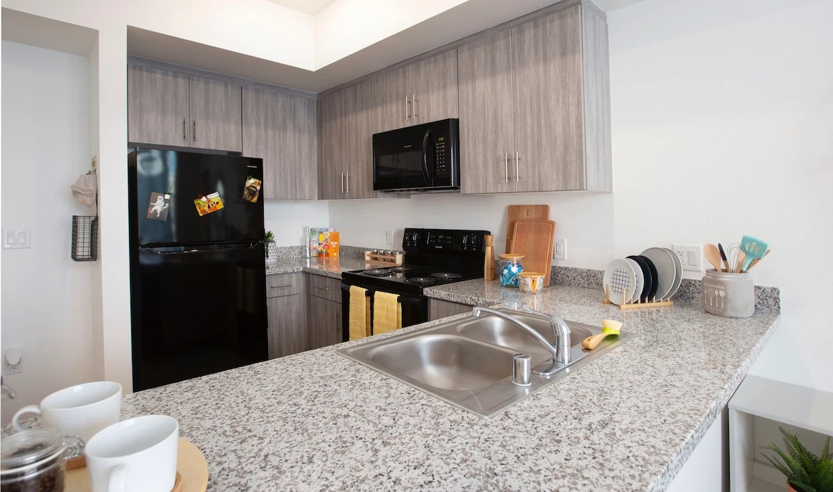
05
Guests, Incidents & Maintenance
Front-desk guest check-in, quick incident reports, and maintenance & key requests.
Notes:
Section five: Guest Log, Incident Reports, and Maintenance and Keys.

Slide 25
ON DUTY
Guest Log: who is on property
Buttons: Restricted-Access Check, Open Kiosk, Send Pre-Registration Link, + Log a Guest.
Stats: On property, Expected today, Check-ins today, Pre-registered, Past expected time.
Today / Week / Month views and search by guest, resident or unit.
Pre-Registered → click Check In when the guest arrives.
Currently On Property → click Check Out when they leave. Watch for the Past expected time flag.
View ID shows the guest’s ID photo.
The Harbour at OCC
🔔 RA Log Out
Dashboard
GUEST LOG
+ Log a Guest
Announcements
On property 3 · Expected 2 · Past expected 1
Program Proposals
Committees
Pre-Registered: Guest → Unit 1111 [Check In]
Schedule & On-Call
On Property: Guest → Unit 2204 [Check Out]
Duty Log
Guest Log
⚠ Past expected time: Guest → Unit 3108
Incident Reports
Maintenance & Keys
Notes:
The Guest Log tracks every guest on property. The top buttons let you run a restricted-access check, open the front-desk kiosk, send a pre-registration link, or log a guest yourself. The stats show who is on property, who is expected, and anyone past their expected time. Pre-registered guests appear in their own list; click Check In when they arrive. Guests on property have a Check Out button. View ID shows the photo of their ID.

Slide 26
ON DUTY
Logging a guest & sending pre-registration links
1
Click + Log a Guest → choose Check in now or Pre-register.
🔗 Pre-Registration Link
Search and select the Resident* (by name or unit).
Click Send Pre-Registration Link
Pick the Resident, expected visit date and link length (3 / 7 / 14 days)
Click Generate Link → Copy link or Email in Gmail
The guest must still check in at the front desk
2
3
Enter Guest full name* (first and last), phone and email.
4
Choose ID type* — Driver’s License, State ID or Student ID — and Take / upload photo of the ID.
5
Set Length of stay (1–4 hours, Until 11:00 PM, Overnight). Add notes if needed.
TIP The resident and property inboxes are emailed by default — leave that box ticked.
6
Click Check In Guest or Pre-Register Guest.
Notes:
To log a guest, click Log a Guest, then choose Check in now or Pre-register. Select the resident they are visiting, enter the guest’s full name and contact information, choose the ID type, and take or upload a photo of the ID. Set the length of stay and click Check In Guest. Residents can also pre-register guests: click Send Pre-Registration Link, select the resident and date, generate the link, and copy or email it. Pre-registered guests must still check in at the front desk.

Slide 27
ON DUTY
Restricted-access check
1
Click Restricted-Access Check, type the guest’s full name, click Check.
IMPORTANT A match is a screening aid, not an identification. Similar names are common. Do not confirm or deny anything to the guest or resident.
2
No match: “Continue the normal guest process.”
3
Possible match: pause the check-in politely.
Contact the on-call REC now.
NOTE Checks can also pop up automatically when you check a guest in. A flagged guest shows Verification required.
4
5
Follow the Campus Safety escalation process.
6
Record the outcome: Escalated to REC / Campus Safety · Not a match — ID verified · Unable to verify identity.
Notes:
The restricted-access check screens a guest’s name against active, verified restrictions. Click Restricted-Access Check, type the full name, and click Check. If there is no match, continue as normal. If there is a possible match, pause the check-in politely, contact the on-call REC right away, and follow the Campus Safety escalation process. Then record the outcome. A match is never an identification, and you should not confirm or deny anything to the guest or resident. This check may also pop up automatically during check-in.

Slide 28
ON DUTY
Incident Reports
Quick Log (this tab)
Incident Report Assistant (full report)
Click + New Incident Report
Who & Where — Resident Name, Room / Unit (optional), Severity: Low / Medium / High
What Happened — Description (required)
Review → Submit Report
You can Edit or Delete your own reports
Use Open Incident Report Assistant → or + New Report on the Dashboard
Guided narrative builder for Maxient-ready reports
Drafts show Draft or Ready for Maxient — click Continue
Duty Log → How to Write an Incident Report
TIP Use the Quick Log to capture it fast — use the Assistant for the official, detailed report. RECs resolve and reopen reports.
Notes:
There are two ways to report incidents. The Incident Reports tab is a quick log: click New Incident Report, add who and where with a severity of low, medium or high, describe what happened, and submit. You can edit or delete your own reports. For the official, detailed report, use the Incident Report Assistant, which guides you through a Maxient-ready narrative. Your drafts appear on the Dashboard with a Continue link. RECs handle resolving and reopening reports.

Slide 29
ON DUTY
Maintenance & Key requests
Click + New Request → choose Maintenance or Key / Lock.
The Harbour at OCC
1
🔔 RA Log Out
2
Select the Resident (saved to their directory record) and the Unit / Bed or Common Area.
Announcements
MAINTENANCE & KEY REQUESTS
+ New Request
Program Proposals
Open 4 · In progress 2 · Resolved 18
Maintenance: Category*, Area, Priority (Normal, Low, Urgent, Emergency).
Committees
3
Schedule & On-Call
Plumbing / Leak · Bathroom · Urgent
Duty Log
Lockout · Unit Key · ✓ Entrata notes
4
Key / Lock: Key Request* (Lockout, Lost Key, Lost Fob, Lock Change…) and Item.
Guest Log
Incident Reports
Light out · Hallway · ✗ Work order
5
Add a Note (200 characters) and tick the Entrata boxes — resident notes and work order # .
Maintenance & Keys
Resident Directory
6
Review → Submit Request. Filter the list by type and status.
TIP Always document in Entrata too. RECs mark requests in progress or resolved.
Notes:
Maintenance and Keys is where you log work orders and key or lock issues. Click New Request and choose Maintenance or Key and Lock. Select the resident, which saves the request to their record, and the unit or area. For maintenance, choose the category, area and priority. For keys, choose the request type and item. Add a short note and confirm whether you documented it in Entrata and submitted a work order. Then submit. RECs mark requests in progress or resolved.

Slide 30
ON DUTY
Key & maintenance SOPs (shown beside the form)
🔑 Key / Lock SOP
🛠 Maintenance SOP
Verify photo ID matches the resident on file
Never admit anyone not on the License Agreement
Log the lockout and any charge
Lost fob: deactivate and request a lock change
Record key/fob numbers and get the resident’s signature
Never lend master or staff keys
Emergency (flood, no heat in winter, gas smell, fire/life safety): call on-call maintenance immediately, then log
Urgent (no water, toilet, no power): notify REC + on-call maintenance same shift
Normal: submit here; remind resident to submit a portal work order
Ask about permission to enter and pets
Photograph damage · follow up within 48 hours
Notes:
Next to the request form you will see the standard procedures. For keys and locks: verify photo ID, never admit anyone not on the License Agreement, log every lockout and charge, deactivate lost fobs, record key numbers with a signature, and never lend master or staff keys. For maintenance: emergencies like floods, gas smells, or fire safety issues mean calling on-call maintenance immediately, then logging. Urgent issues get reported to your REC and maintenance the same shift. Normal requests go here, and remind residents to submit a portal work order. Ask about permission to enter and pets, photograph damage, and follow up within forty-eight hours.

Slide 31
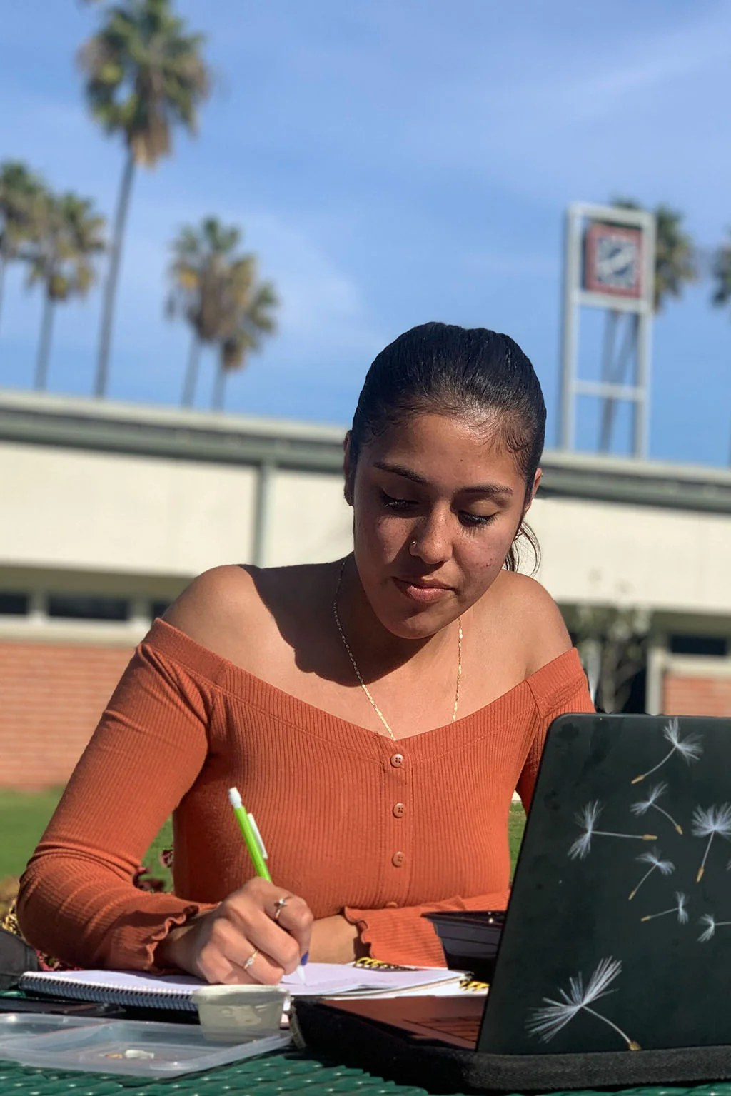
06
Reference Tools
Resident Directory, Campus Contacts, Curriculum, SOPs, Resources and Training.
Notes:
Section six: your reference tools.

Slide 32
REFERENCE
Resident Directory
1
Search by name, unit or email; filter by building, floor, tag or RA (Clear filters resets).
IMPORTANT Non-Leasing Occupant (minor) notice: they are not on the License Agreement — contact the primary resident about anything involving them.
2
Click a resident to open their profile: unit, bed, building/floor, roommates, email and phone.
3
Profile tabs: Overview, Incidents, Violations, Duty Log, Guests, Keys / Locks, Maintenance.
PRIVACY Resident information is confidential. Only use it for your RA duties, and never share it with other residents.
4
On Keys / Locks you can add an entry: type + details → Add Entry.
5
Click a roommate to jump to their profile. Backspace goes back, Esc closes.
Notes:
The Resident Directory lets you look up residents. Search by name, unit or email, or filter by building, floor, tag or RA. Click a resident to open their profile with their unit, bed, roommates and contact information, plus tabs for incidents, violations, duty log mentions, guests, keys and maintenance. You can add key and lock entries from the profile. If you see a non-leasing occupant notice, that resident is a minor who is not on the License Agreement, so contact the primary resident. Resident information is confidential; use it only for your RA duties.

Slide 33
REFERENCE
Campus Contacts
Search by name, department, email or category (Academic, Safety, Financial, Health & Wellness, Student Organizations).
The Harbour at OCC
1
🔔 RA Log Out
Program Proposals
CAMPUS PARTNER CONTACTS
2
Click a card to see Why Contact Them, Capstone Contacts to Include and notes.
Committees
Schedule & On-Call
Campus Safety · Safety · ✉ Email
Duty Log
Student Health Center · Health & Wellness
3
Click ✉ Email This Contact — listed Capstone staff are copied automatically.
Guest Log
Incident Reports
Financial Aid · Financial
Maintenance & Keys
Student Life · Student Organizations
4
Need several? ✉ Email Multiple Contacts → tick contacts or Select All → ✉ Open Email.
Resident Directory
Campus Contacts
Notes:
Campus Contacts is your directory of campus partners. Search by name, department or category. Click a contact to see why you would reach out to them and which Capstone staff to include. Email This Contact opens an email with those staff already copied. To email several partners at once, click Email Multiple Contacts, select them, and click Open Email.

Slide 34
REFERENCE
Curriculum, SOP Library & Resources
📋 Curriculum Tracker
📘 SOP Library
🔗 Resources
Pick a semester to see the grid of requirements and due dates by RA
Read-only — your REC marks completions
Open Curriculum Management → for the full view
Opens the property’s written procedures in its own page
Search, read and follow the steps
Acknowledge SOPs when asked
Reference links grouped by category — click Open
Includes The Harbour Information Library
Search with “Search resources…”
TIP When you are unsure how to handle something, check the SOP Library first, then ask your REC.
Notes:
The Curriculum Tracker shows which requirements are due by semester. It is read-only for RAs; your REC marks completions, and Open Curriculum Management gives the full view. The SOP Library opens the property’s written procedures; read them, follow the steps, and acknowledge them when asked. Resources has helpful links grouped by category, including The Harbour Information Library. When you are unsure how to handle something, check the SOP Library first, then ask your REC.

Slide 35
REFERENCE
Training Modules
Open Training Modules → each card shows the category, title, description and lesson.
The Harbour at OCC
1
🔔 RA Log Out
Guest Log
TRAINING MODULES
2
Some modules link to Canvas / External Course — complete that first.
Incident Reports
Maintenance & Keys
Emergency Response · Passed · 90%
Click Take Quiz (N questions) and answer every question.
Resident Directory
Guest Policy · Attempted · 70% [Retake]
3
Campus Contacts
Curriculum Tracker
Duty Log Basics · [Take Quiz (8 questions)]
Click Submit Quiz — you will see ✔ Passed or ✘ Not Passed with your score (pass mark usually 80%).
SOP Library
Title IX Awareness · Open in Canvas
4
Resources
Training Modules
5
Not passed? Review the lesson and click Retake Quiz.
Notes:
Training Modules holds your required lessons and quizzes. Read the lesson on each card, and complete any linked Canvas or external course. Then click Take Quiz, answer every question, and Submit. You will see if you passed, with your score; the pass mark is usually eighty percent. If you did not pass, review the lesson and retake the quiz.

Slide 36

07
Creative Studio
Create on-brand flyers, posts, signs, emails and campaigns — then submit for approval.
Notes:
Section seven: the Creative Studio.

Slide 37
CREATIVE STUDIO
Creative Studio: getting there & Home
1
In the Hub sidebar click Creative Studio. ← Hub brings you back.
Creative Studio RA
Create something for your community.
2
Use quick buttons: Create Event, Create Flyer, Send Resident Update, Create Social Post, Create Sign, Create Resource Guide.
✦ Make me a flyer for a resident game night… [Create]
3
Or use the ✦ AI Assistant: describe it (e.g. “a flyer for a resident game night”), pick an audience, click Create.
Flyer
Social
Event
Sign
4
Home also shows Favorites, Recommended, Recent Projects, Approved Examples and the Brand Kit.
5
Use the top search to find templates, examples, resources and projects.
Notes:
The Creative Studio is where you make on-brand flyers, social posts, signs, emails and more. Open it from the Hub sidebar; the Hub link brings you back. On Home, use a quick button like Create Flyer, or try the AI Assistant: describe what you need, pick the audience, and click Create. You will also see your favorites, recent projects, approved examples, and the brand kit. The search bar at the top finds templates, examples and projects.

Slide 38
CREATIVE STUDIO
Templates & the design editor
1 · Pick a template
2 · Edit
3 · Check & save
Filter by group and format, or ★ Favorites
Hover → Preview or Use Template
☆ to favorite templates you reuse
Content: headline, date, time, location, call to action, QR link, contact
AI: Write, Make Shorter, Friendlier, Fix Grammar, Social Caption, SMS / Email version
Images: Photo Library or an Entrata Media Library link
Layout: Letter, Notice, Post, Story, Sign
Brand check: “Looks on-brand and ready to export” or warnings to fix
Save Draft anytime
Submit for Approval when ready
Download ▾ PNG / PDF / Print PDF (300 dpi)
IMPORTANT Brand colors, fonts and logos are locked. Always proofread dates, times and locations — AI drafts must be reviewed.
Notes:
In Templates, filter by type and format, preview a design, and click Use Template. In the editor, the Content tab holds your headline, date, time, location and call to action. AI tools can write copy, shorten it, fix grammar, or create a social caption, text or email version. Choose images from the Photo Library or an Entrata media link, and switch layouts between letter, post, story and sign. Brand colors, fonts and logos are locked so everything stays on-brand. Watch the brand check, save drafts as you go, and submit for approval when it is ready. Always proofread details, especially anything AI wrote.

Slide 39
CREATIVE STUDIO
Campaigns & Communications
📣 Campaigns — one event, every format
✉️ Communications — approved copy
Enter Event name, Date, Time, Location, Description, Photo, Audience
Click Generate Campaign
Get an 8.5×11 flyer, Instagram post & story, digital sign, resident email, SMS reminder and caption
Save all to My Projects
Browse approved email, text and social templates by channel & category
Use This Template or Copy
AI rewrites, SMS counter (160 characters per segment) and wording check
Turn into a flyer · Save to My Projects
IMPORTANT Emergency templates: verify every detail with your supervisor before sending.
Notes:
Campaigns turns one event into every format at once. Enter the event details, click Generate Campaign, and you get a flyer, Instagram post and story, a digital sign, a resident email, a text reminder and a caption. Save them all to My Projects. Communications has approved email, text and social copy. Use a template or copy it, rewrite with AI, and watch the SMS counter. For emergency templates, always verify every detail with your supervisor before sending.

Slide 40
CREATIVE STUDIO
Newsletter, Entrata HTML, Brand Kit & Photos
📰 Monthly Newsletter
🧩 HTML – Entrata
Build with blocks, Preview, Validate, Send Test, Save Draft, Copy Entrata HTML. Approval is done by RECs/Admins.
Paste or upload Entrata HTML and edit text only — layout, styles, links and images stay locked.
🎨 Brand Kit
📷 Photos
Logos, logo rules, colors (click to copy), typography, graphics and brand voice.
Browse approved photos and copy links. Need a new image? Ask an REC or Admin to add it.
Brand words: “License Agreement” (not lease) · “Resident” (not tenant) · “The Harbour” (not Harbor) · “Guarantor” (not cosigner)
Notes:
The Monthly Newsletter builder lets you assemble blocks, preview, validate, send a test, and copy the Entrata HTML; RECs and Admins approve it. HTML Entrata lets you safely edit just the text of an existing Entrata email. The Brand Kit has our logos, colors, fonts, graphics and voice. Photos lets you browse approved images; ask an REC or Admin if you need a new one added. And remember our brand words: License Agreement, not lease; Resident, not tenant; The Harbour, spelled H-A-R-B-O-U-R; and Guarantor, not cosigner.

Slide 41
CREATIVE STUDIO
My Projects, Creative Library & approval
Draft
Save Draft anytime
Pending approval
You click Submit for Approval
Approved
REC/Admin approves — 🔔 you’re notified
Sent back
Fix using the reviewer’s note, resubmit
➜
➜
➜
📁 My Projects
🖼 Creative Library
Folders: All, My pending, Approved, Drafts, Archived
+ New Project, new folders
Edit · Duplicate · Download · Archive / Restore
+ Upload Creative (images & PDFs)
Uploads stay pending until an Admin or REC approves
TIP Editing approved work sends it back to pending. Never post anything publicly until it is approved.
Notes:
Here is how creative approval works. Save drafts anytime. When you are ready, click Submit for Approval and the project becomes pending. An REC or Admin either approves it, or sends it back with a note; either way you get a bell notification. If it is sent back, fix it and resubmit. If you edit approved work, it goes back to pending. My Projects organizes your work into folders like My pending, Approved and Drafts. The Creative Library lets you upload images and PDFs, which stay pending until approved. Never post anything publicly until it is approved.

Slide 42
WRAP-UP
Quick reference: RA can / REC & Admin handle
✅ You can
🔒 REC & Admin handle
Read announcements & get notifications
Create, submit, edit & evaluate your programs
Log committee minutes
Offer, swap, pick up shifts; set availability
Start, add to and submit Duty Logs
Check guests in/out; run restricted-access checks
Log incidents, maintenance & key requests
Look up residents; add key/lock entries
Take training quizzes; create & submit creative
Posting & pinning announcements
Approving programs, budgets & creative
Building & publishing schedules; approving swaps/time off
Reopening others’ duty logs; unlocking edits
Resolving incidents & maintenance requests
Editing resident records, tags & notes
Safety records, conduct meetings, accommodations
Managing users, contacts, locations & settings
Notes:
Here is a quick reference. As an RA you can read announcements, create and submit your programs, log committee minutes, manage your shifts and availability, complete Duty Logs, handle guests, log incidents and maintenance, look up residents, take training quizzes, and create creative work for approval. RECs and Admins handle approvals, publishing schedules, unlocking logs, resolving requests, editing resident records, restricted records like safety and conduct meetings, and system settings.

Slide 43
WRAP-UP
Best practices
🔐
Protect privacy
⏱
Document in real time
📤
Submit on time
No resident names or Student IDs in Duty Log responses. Resident info is for RA duties only.
Add Duty Log entries as calls happen — not from memory hours later.
Submit your Duty Log at the end of every duty period and meet program deadlines.
📞
Escalate early
🧾
Follow purchasing rules
💬
Speak up
Know the on-call escalation list. When in doubt, call your on-call REC.
Emburse card only, local vendors for food, include all fees and tips.
Use the Feedback button to report bugs or suggest improvements.
Notes:
To wrap up, a few best practices. Protect resident privacy. Document in real time while details are fresh. Submit your Duty Log at the end of every duty period and meet your program deadlines. Escalate early; when in doubt, call your on-call REC. Follow the purchasing rules. And use the Feedback button whenever something is not working or could be better.

Slide 44
You’re ready!
Questions? Ask your REC, or use the Feedback button in the Hub.
theharbourocc.com
Notes:
That completes your ResLife Hub and Creative Studio training. You are ready to go. If you have questions, ask your REC, or use the Feedback button in the Hub. Thank you for everything you do for our residents at The Harbour.

